Slide 1
Identifying the best suited cities in Ile-de-France for a Family
Fatima-Zahra KARKOURI
Capstone Project
IBM Data Science Professional Certificate

Slide 2

Introduction
Île-de-France counts:
18% of the total population of France
30% of the national GDP
1268 municipalities around Paris
Problem:
A saturated capital where to settle and form a family without impacting the quality of life Paris offers?
The study objective:
Establish clusters of cities, in order to help families choose the best fit for their future projects.

Slide 3
Data
Foursquare API: To retrieve the venues of each City
https://data.iledefrance.fr/: The open data platform of the Île-de-France region, which we will use to get :
The geographical coordinates of the cities.
The number of schools.
The health services per city.

Slide 4
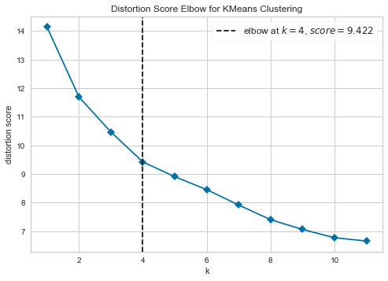
K-Means
The Elbow method to determin the optimal number of clusters. The results of the method was 4 clusters.
The algorithm was run using Sci kit learn Package.

Slide 5
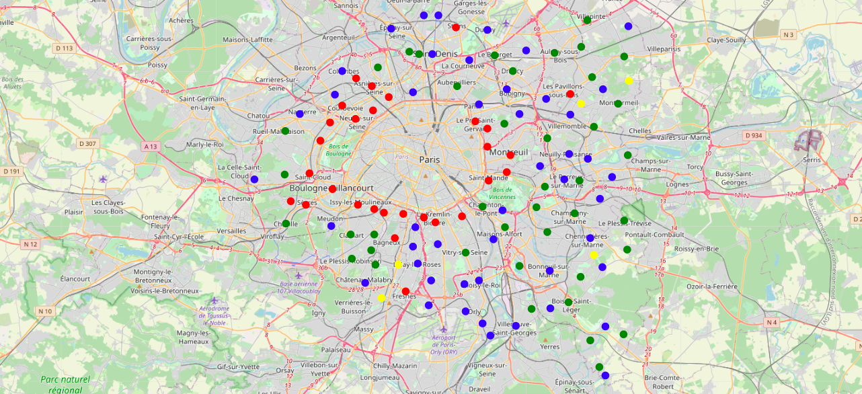
Results : Clusters on the Map
Cluster 0: Are marked with green circles. | Cluster 2: Are marked with yellow circles.
Cluster 1: Are marked with red circles. | Cluster 3: Are marked with blue circles.

Slide 6
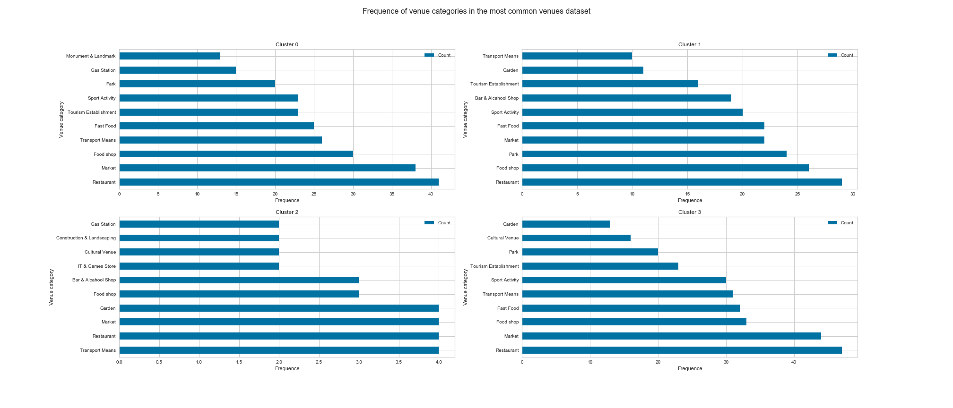
Results : Most Common Venues

Slide 7
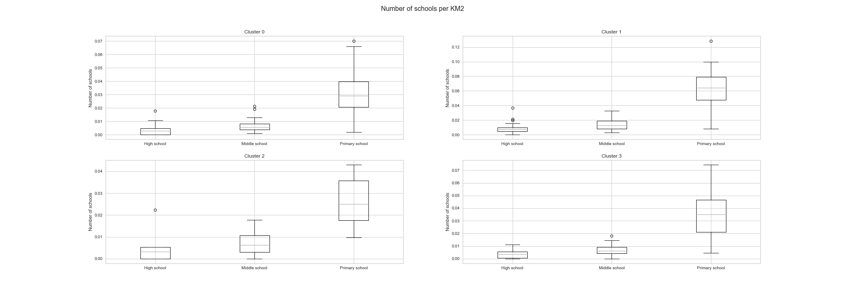
Results:Schools per Square KM
25% of the cities of Cluster 1 have one school per 28.57 square Km
75% of the cities of Cluster 1 one school per 15.40 square Km
The 3 other clusters more than 75% of their cities have less than one school per 25 square Km

Slide 8
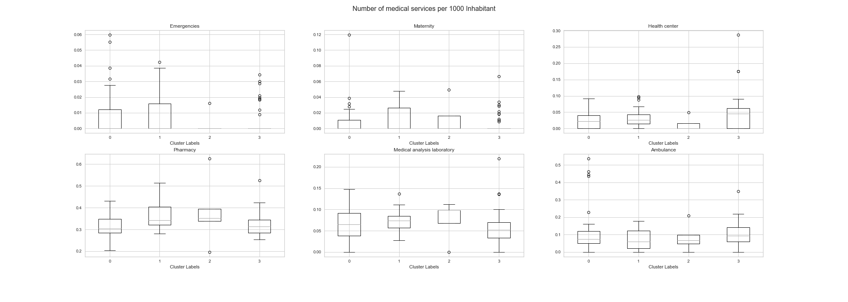
Results : Health Services
More than 50% don't have emergency and maternity
Distribution at the department level
The distribution of ambulances is balanced between the 3 clusters.
We can deduce that although hospitals and emergency services are centralized in some municipalities, ambulances are distributed fairly to serve them.

Slide 9
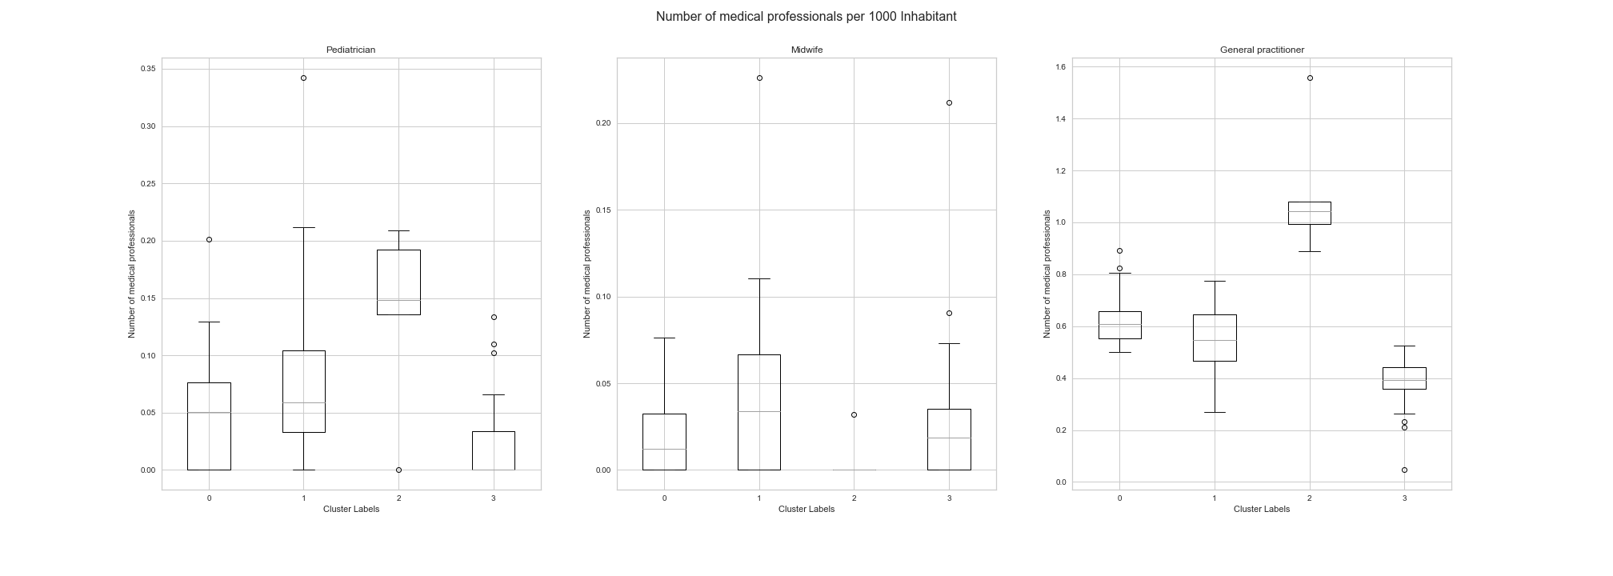
Results : Health Professionals
Cluster 2 has a median of 15 pediatrician per 100000 inhabitants (1 pediatrician for all 6666 inhabitants).
Cluster 2 has a median of 11 general practitioner per 10000 inhabitants whereas the Clusters 0 and 1 counts an Upper Quartile of approximatly 7 per 10000 inhabitants.

Slide 10
Discussion
Common venues in all clusters : Restaurants, markets, food markets, and pharmacies.
Cluster 0 : Potential tourists destination
Large number of tourist sites.
Significant transport offer.
Cluster 1 : More suited for a Family with or planning to have children,
Large number of parks, gardens, and sport activities spaces.
More schools compared to other clusters.
Cluster 2 : Ideal for young people seeking an active life
Big presence of places of entertainment.
Cluster 3 : Hosting companies
Important transport service.
More fast food.

Slide 11
Conclusion
To have more convincing and more reliable results, it is necessary to take into consideration the future development plans of these cities and the demographic predictions.
The number, quality, and precision of the data will allow the full potential of machine learning algorithms to be exploited,
Beyond the technical and coding aspects, knowledge and research in the field to be studied are necessary to carry out a study.

